Slide 1
Introduction to Computation
Fan Cheng Shanghai Jiao Tong University
http://www.cs.sjtu.edu.cn/~chengfan/
chengfan@sjtu.edu.cn
Autumn, 2022

Slide 2
Outline
Random number
File processing
List comprehension

Slide 3


Random number
“God does not play dice with the universe.” -- Einstein
To play a game of chance where the computer needs to throw some dice, pick a number, or flip a coin
To shuffle a deck of playing cards randomly
To allow/make an enemy spaceship appear at a random location and start shooting at the player
To simulate possible rainfall when we make a computerized model for estimating the environmental impact of building a dam
For encrypting banking sessions on the Internet
Integers: uniform distributed, random permutation, random sampling
Real numbers: uniform, Gaussian
import random # py module

Slide 4
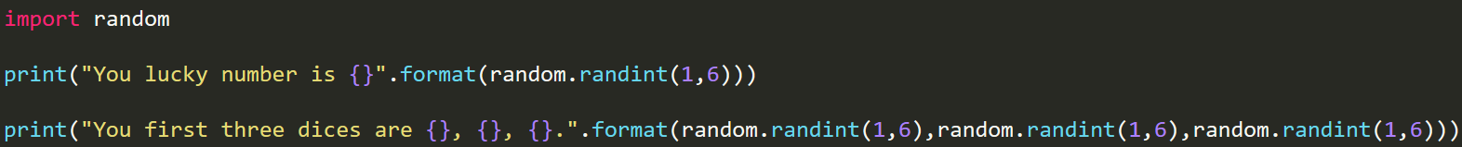
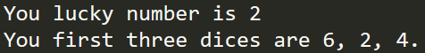
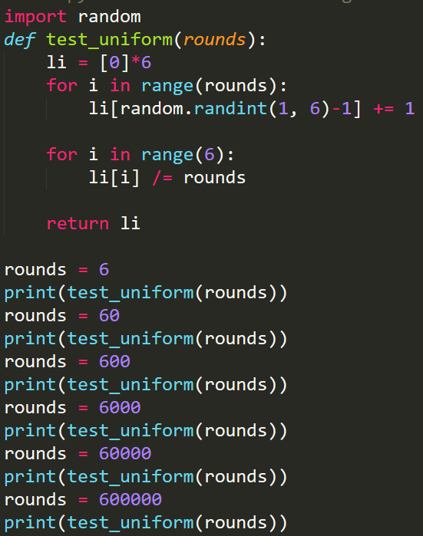
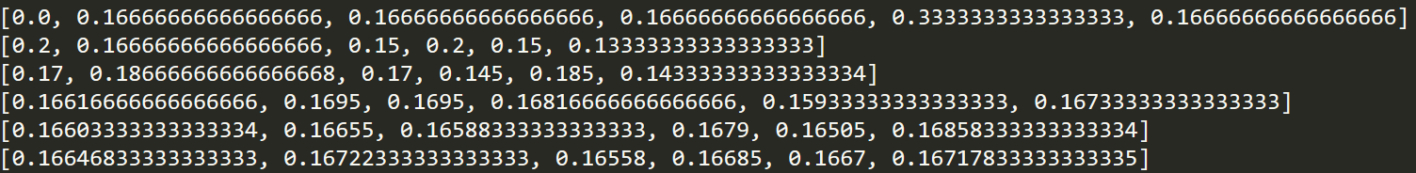
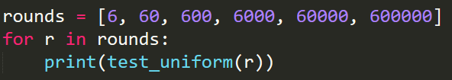
Random integer
random.randint(a, b): Return a random integer N such that a <= N <= b
As rounds grows, the probability goes to 1/6$∼0.166$

Slide 5
Random integer (cont’d)
random.randrange(start, stop, step): Return a randomly selected element from range(start, stop, step)
random.randrange(stop)
Recall: range(a, b) = [a, b) (b is not included!)
Random.randit(a, b) = random.randrange(a, b+1)
Implement the following functions (the same with the previous lectures)
Roll the dice to get your lucky number
Roll three dices to see your luckiness
Roll the dices to validate that the dice is uniformly handcrafted

Slide 6
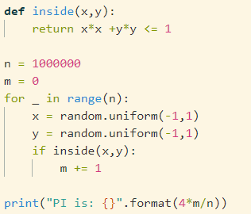
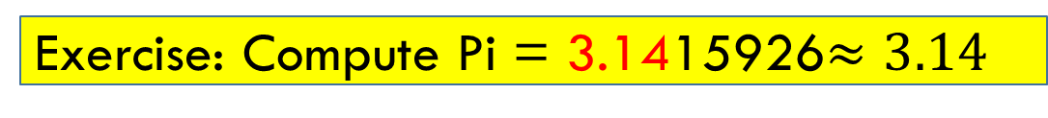
Random floating number
https://docs.python.org/3/library/random.html
random.random() Return the next random floating point number in the range [0.0, 1.0).
random.uniform(a, b) Return a random floating point number N such that a <= N <= b for a <= b and b <= N <= a for b < a.
The end-point value b may or may not be included in the range depending on floating-point rounding in the equation a + (b-a) * random().
Exercise: Compute Pi = 3.1415926$≈3.14$

Slide 7
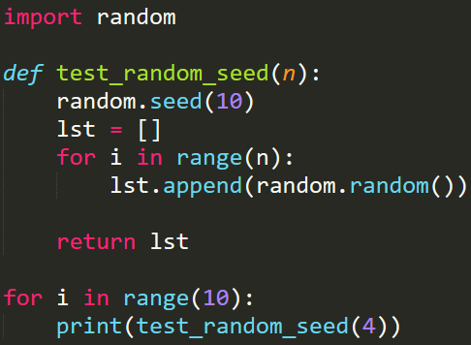
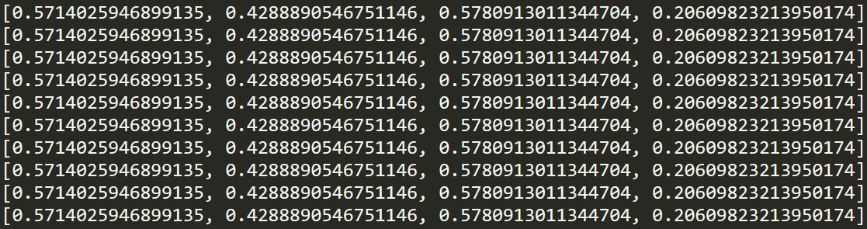
Seed (随机数种子)
The random.seed() method is used to initialize the random number generator
The random number generator needs a number to start with (a seed value), to be able to generate a random number
By default the random number generator uses the current system time
Use the seed() method to customize the start number of the random number generator
If you use the same seed value twice you will get the same random number twice
仿真实验需要

Slide 8
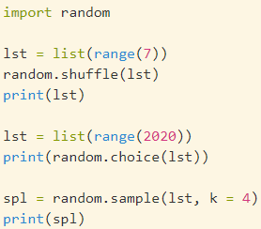
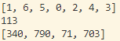
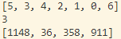
Random: choice(), shuffle(), sample()
random.choice(): Return a random element from the non-empty sequence seq
random.choices(population, weights=None, *, cum_weights=None, k=1): Return a k sized list of elements chosen from the population with replacement.
random.shuffle(): Shuffle the sequence x in place
random.sample(): Return a k length list of unique elements chosen from the population sequence or set.
https://docs.python.org/3/library/random.html

Slide 9

File

Slide 10
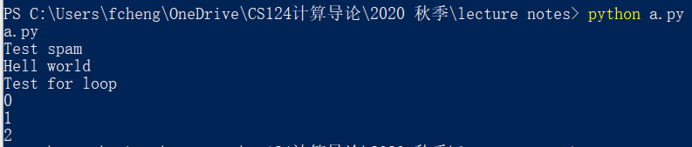
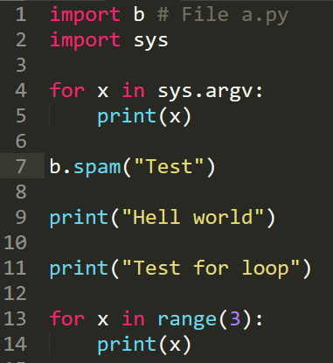
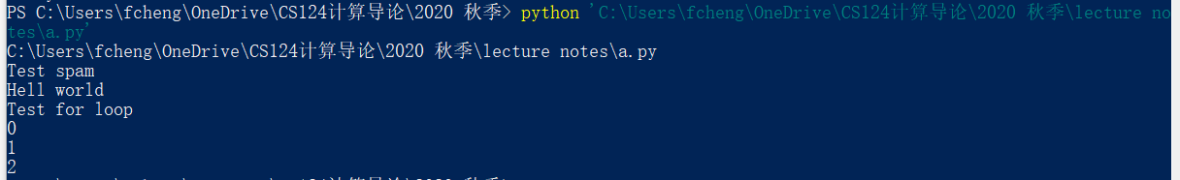
绝对路径 VS 相对路径
Shell中，路径名有空格用”xxx”处理
Shell
In powershell (windows) or shell (linux, mac), “cd” means change directory
current working directory (CWD): 当前工作目录
An absolute path, which always begins with the root folder (C:\windows\....\a.txt)
A relative path, which is relative to the program’s current working directory (\a\b.txt)
. : current directory. “./a.py”
.. : the parent directory. “cd ..” 返回上级目录
Run python program via shell: python filename.py
filename.py should be in the current working directory (当前工作目录)
Or python C:\xxxx\....\filename.py (绝对路径)

Slide 11
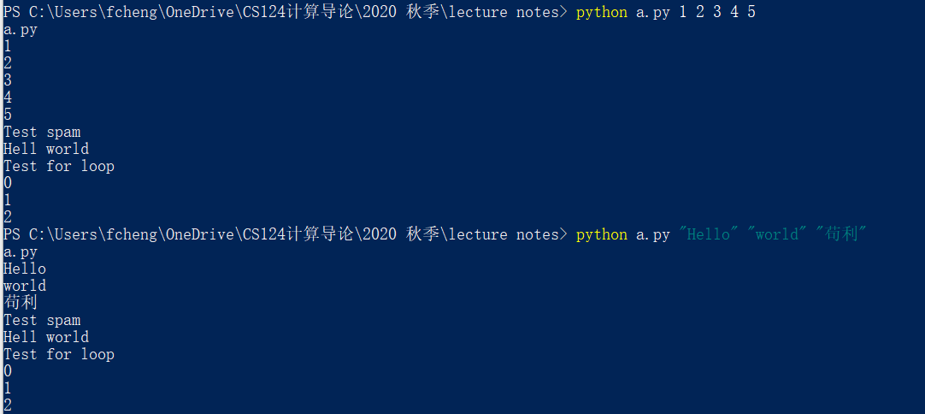
VS Code: Ctrl+F5
与Code Runner的默认配置不一样
Shell: parameter
Run python program via shell with parameters:
python filename.py parameter1 parameter2 parameter3 …

Slide 12

Ubuntu
计算机方向的本科生一定要尽早接触Linux
https://ubuntu.com/
练习用它来替代windows做一切事情: 写报告，写代码等等
C++
Python
Shell
Office等等
开源: 没什么比源码更重要了
可以在windows下面装: 虚拟机+ubuntu
Mac和Linux用起来差距不大
打开一个新世界
自己寒假折腾

Slide 13
Module: sys
https://docs.python.org/3/library/sys.html
https://www.python-course.eu/sys_module.php
System-specific parameters and functions: This module provides access to some variables used or maintained by the interpreter and to functions that interact strongly with the interpreter. It is always available
Manipulate different parts of the Python runtime environment
sys.version: This attribute displays a string containing the version number of the current Python interpreter
sys.argv: sys.argv returns a list of command line arguments passed to a Python script.
sys.path: This is an environment variable that is a search path for all Python modules.
sys.path[0]: current directory of the file
sys.exit: This causes the script to exit back to either the Python console or the command prompt. This is generally used to safely exit from the program in case of generation of an exception.
sys.maxsize: Returns the largest integer a variable can take.
sys.stdin, sys.stdout and sys.stderr: Standard data streams

Slide 14
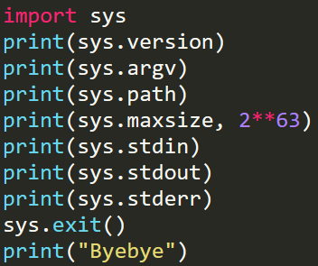
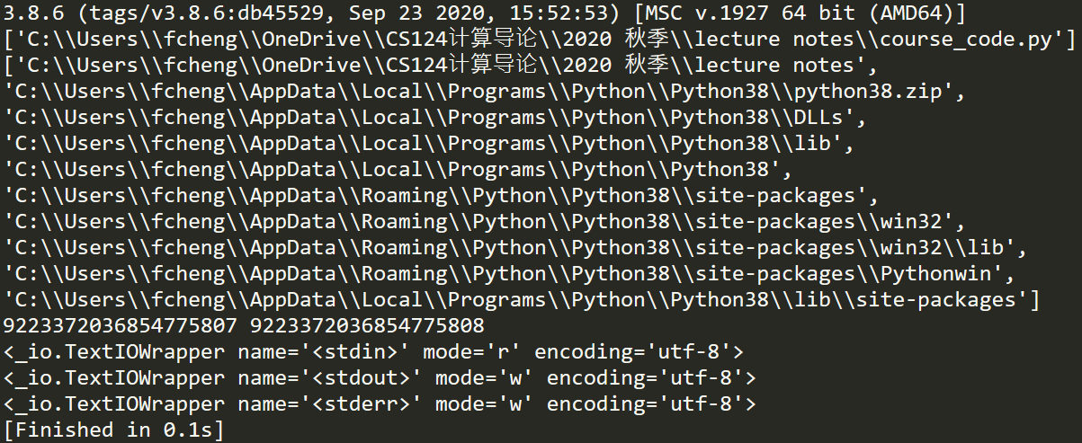

Slide 15
Module: sys.argv
sys.argv: sys.argv returns a list of command line arguments passed to a Python script. sys.argv[0] contains the script file name xxx.py; sys.argv[1] contains the first parameter , while sys.argv[2] contains the second parameter
>>>python course_code.py a b c d
>>>['course_code.py', 'a', 'b', 'c', 'd']

Slide 16
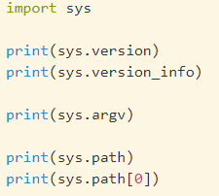
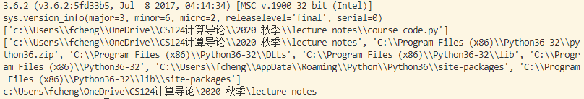
Module: sys.path
sys.path: This is an environment variable that is a search path for all Python modules.
A list of strings that specifies the search path for modules. Initialized from the environment variable PYTHONPATH, plus an installation-dependent default.
sys.path[0]: current directory of the file
As initialized upon program startup, the first item of this list, path[0], is the directory containing the script that was used to invoke the Python interpreter. If the script directory is not available (e.g. if the interpreter is invoked interactively or if the script is read from standard input), path[0] is the empty string, which directs Python to search modules in the current directory first. Notice that the script directory is inserted before the entries inserted as a result of PYTHONPATH.
绝对路径：sys.path[0] + 文件名

Slide 17
Module: standard streams
Every serious user of a UNIX or Linux operating system knows standard streams, i.e. input, standard output and standard error. They are known as pipes. They are commonly abbreviated as stdin, stdout, stderr.
The standard input (stdin) is normally connected to the keyboard, while the standard error and standard output go to the terminal (or window) in which you are working.
These data streams can be accessed from Python via the objects of the sys module with the same names, i.e. sys.stdin, sys.stdout and sys.stderr.

Slide 18
Module: os 操作系统
OS: Operation system. This module provides a portable way of using operating system dependent functionality.
https://docs.python.org/3/library/os.html
os.name
os.environ, os.getenv() and os.putenv(): 环境变量
os.chdir() and os.getcwd(): 改变工作目录、查询当前目录
os.mkdir() and os.makedirs(): 创建目录
os.remove() and os.rmdir(): 删除文件、目录 (当心重要文件！！！！！！)
os.rename(src, dst): 重命名
os.startfile(): 修改程序的 打开方式
os.walk()：遍历一个路径下面所有目录和文件
os.path
basename, dirname, exists, isdir and isfile, join, split
https://python101.pythonlibrary.org/chapter16_os.html

Slide 19
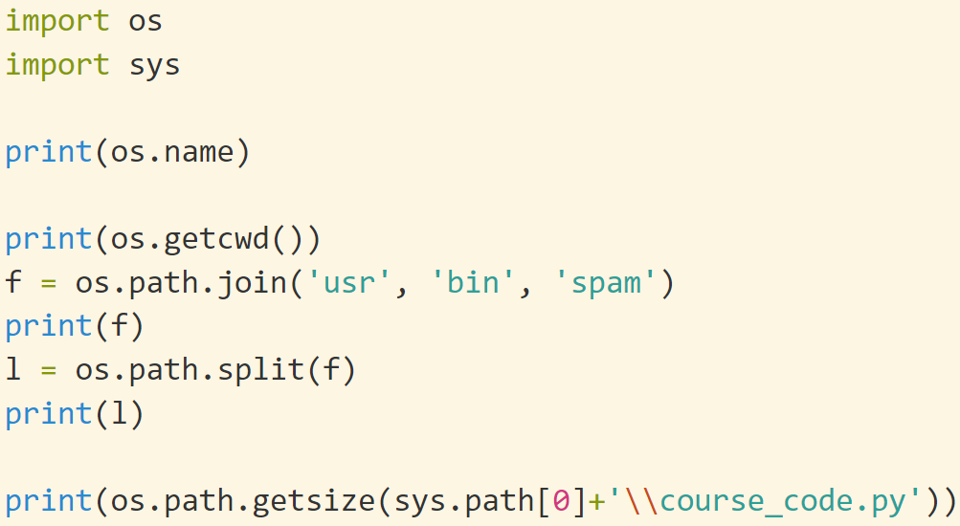
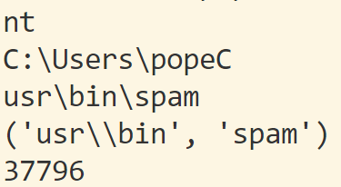
https://docs.python.org/3.3/library/os.path.html?highlight=path#module-os.path
Module: os

Slide 20

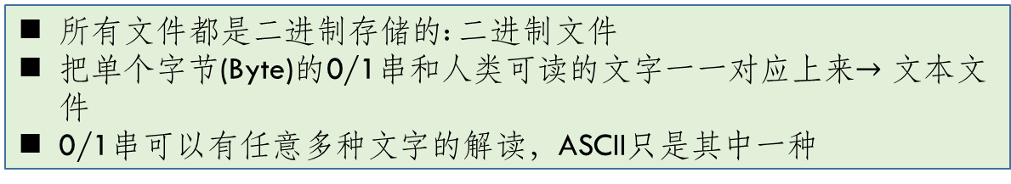
Binary File
所有文件都是二进制存储的: 二进制文件
把单个字节(Byte)的0/1串和人类可读的文字一一对应上来$→$ 文本文件
0/1串可以有任意多种文字的解读，ASCII只是其中一种
Binary file are those typical files that store data in the form of sequence of bytes grouped into eight bits or sometimes sixteen bits. These bits represent custom data and such files can store multiple types of data (images, audio, text, etc) under a single file
Binary file can have custom file formats and the developer, who designs these custom file formats, converts the information, to be stored, in bits and arranges these bits in binary file so that they are well understood by the supporting application and when needed, can easily be read by the supporting application
One most common example of binary file is image file is .PNG or .JPG. If one tries open these files using a text editor then, he/she may get unrecognizable characters, but when opened using the supporting image viewer, the file will be shown as a single image. This is because the file is in binary format and contains data in the form of sequence of bytes. When the text editor tries to read these bytes and tries to convert bits into characters, they get undesired special characters and display it to the user

Slide 21
Text File
Text files are special subset of binary files that are used to store human readable characters as a rich text document or plain text document. Text files also store data in sequential bytes but bits in text file represents characters.
Text files are less prone to get corrupted as any undesired change may just show up once the file is opened and then can easily be removed.
Text files are of two types:
Plain text files: These files store End of Line (EOL) marker at the end of each line to represent line break and an End of File (EOF) at the end of the file to represent end of file.
Rich text files: These files also follow the same schema as the plain text files but may also store text related information like text colour, text style, font style etc.
Because of simple and standard format to store data, text files are one of the most used file formats for storing textual data and are supported in many applications.
和文本的编码格式相关：UTF, GB2312等等

Slide 22
Store data in file
Reminder: Computers have cache, memory, hard disk. What are the major differences in speed and price?
While a program is running, its data is stored in random access memory (RAM). RAM is fast and inexpensive, but when the program ends, or the computer shuts down, data in RAM will be lost
To make data available the next time the computer is turned on and the program is started, it has to be written to a non-volatile storage medium, such a hard drive, usb drive, or CD-RW
Data on non-volatile storage media is stored in named locations on the media called files
Working with files is a lot like working with a notebook.
To use a notebook, it has to be opened.
When done, it has to be closed
In python, a file object will be created to operate the file
open(filename, mode): returns a file object, default mode is “read”
close(): free up any system resources taken up by the open file.

Slide 23
open()
Before you can read or write a file, you have to open it using Python's built-in open() function. This function creates a file object, which would be utilized to call other support methods associated with it.
Syntax: file object = open(file_name [, access_mode][, buffering])
Here are parameter details −
file_name − The file_name argument is a string value that contains the name of the file that you want to access.
access_mode − The access_mode determines the mode in which the file has to be opened, i.e., read, write, append, etc. A complete list of possible values is given below in the table. This is an optional parameter and the default file access mode is read (r).
buffering − If the buffering value is set to 0, no buffering takes place. If the buffering value is 1, line buffering is performed while accessing a file. If you specify the buffering value as an integer greater than 1, then buffering action is performed with the indicated buffer size. If negative, the buffer size is the system default(default behavior).
Here is a list of the different modes of opening a file −
r: read; w: write; b: binary; +: read and write; a: appending
Modes can be mixed

Slide 24
Mode | Description
r | Opens a file for reading only. The file pointer is placed at the beginning of the file. This is the default mode.
rb | Opens a file for reading only in binary format. The file pointer is placed at the beginning of the file. This is the default mode.
r+ | Opens a file for both reading and writing. The file pointer placed at the beginning of the file.
rb+ | Opens a file for both reading and writing in binary format. The file pointer placed at the beginning of the file.
w | Opens a file for writing only. Overwrites the file if the file exists. If the file does not exist, creates a new file for writing.
wb | Opens a file for writing only in binary format. Overwrites the file if the file exists. If the file does not exist, creates a new file for writing.
w+ | Opens a file for both writing and reading. Overwrites the existing file if the file exists. If the file does not exist, creates a new file for reading and writing.
wb+ | Opens a file for both writing and reading in binary format. Overwrites the existing file if the file exists. If the file does not exist, creates a new file for reading and writing.
a | Opens a file for appending. The file pointer is at the end of the file if the file exists. That is, the file is in the append mode. If the file does not exist, it creates a new file for writing.
ab | Opens a file for appending in binary format. The file pointer is at the end of the file if the file exists. That is, the file is in the append mode. If the file does not exist, it creates a new file for writing.
a+ | Opens a file for both appending and reading. The file pointer is at the end of the file if the file exists. The file opens in the append mode. If the file does not exist, it creates a new file for reading and writing.
ab+ | Opens a file for both appending and reading in binary format. The file pointer is at the end of the file if the file exists. The file opens in the append mode. If the file does not exist, it creates a new file for reading and writing.
w mode is very very very dangerous! It may destroy your data

Slide 25
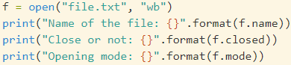
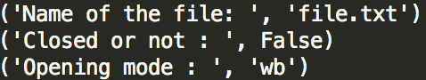
File object
Here is a list of all the attributes related to a file object −
file.closed: Returns true if file is closed, false otherwise
file.mode: Returns access mode with which file was opened
file.name: Returns name of the file
Binary file
Text file
文件是一串0/1数列。文件操作就是将这串数列读入内存或者写到文件
文件常见错误
Python源文件和读写的文件不在同一个目录 (相对路径)
当前VS Code的工作目录和读写文件不同，特别注意 (绝对路径或者改变cwd)

Slide 26
Path (路径): pathlib
Windows: C:\windows\xxxx\
Mac and Linux: C:/usr/xxxxx
历史遗留问题: early 1980’s computer history
By hand: No!!!!!!
os.path: You can use os.path.join() to build a path string using the right kind of slash for the current operating system
pathlib: python 3.4
You should use forward slashes / with pathlib functions
The Path() object will convert forward slashes into the correct kind of slash for the current operating system. Nice!
If you want to add on to the path, you can use the / operator directly in your code. Say goodbye to typing out os.path.join(a, b) over and over

Slide 27
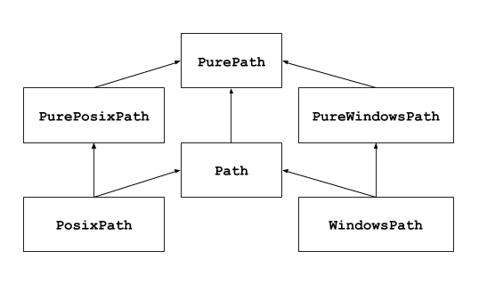
Path (路径): pathlib
pathlib — Object-oriented filesystem paths 推荐使用
https://docs.python.org/3/library/pathlib.html 所有相关方法
This module offers classes representing filesystem paths with semantics appropriate for different operating systems. Path classes are divided between pure paths, which provide purely computational operations without I/O, and concrete paths, which inherit from pure paths but also provide I/O operations.
Path, PosixPath, WindowsPath

Slide 28
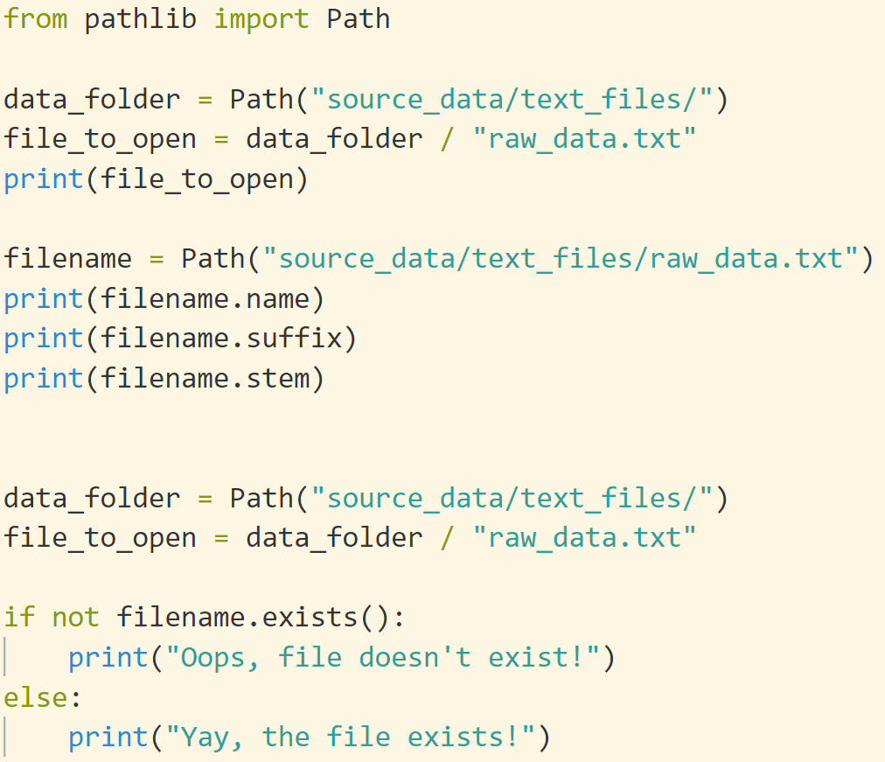
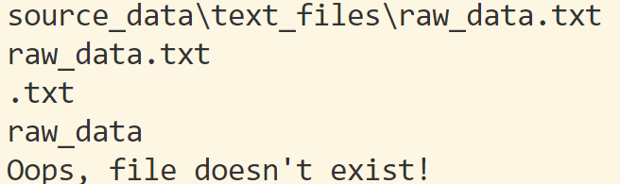
Path (路径): pathlib
直接用 “/”, 不需要考虑OS平台

Slide 29
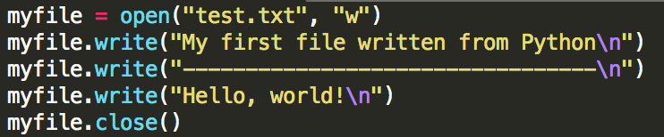
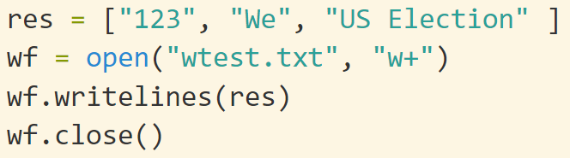
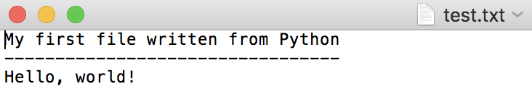
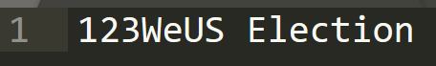
Write into Files: write(), writelines()
When you open() a file, do remember to close() it
A file object can call write() to write data into the file
f.write(string) writes the contents of string to the file, returning the number of characters written. The write() method does not add a newline character ('\n') to the end of the string
f.writelines (lines) Writes a list of lines to the file. Must be str. No “\n” added
With mode “w” (means write)
if there is no file named “test.txt” on the disk, it will be created.
If there already is one, it will be replaced by the file we are writing!!!!!!
Always open() and close() in pair

Slide 30
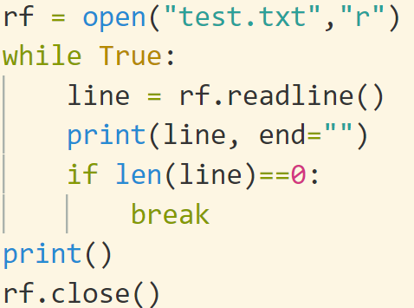
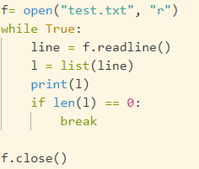
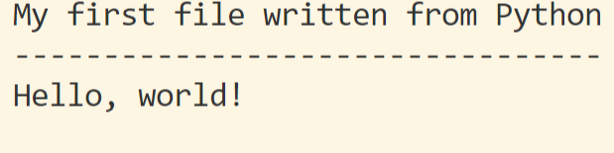
Read from files: read(), readline(), readlines()
There are three major methods to read from a file:
readline() method returns everything in “string” up to and including the newline character. ‘\n’ will be read in
input(): terminate when ‘\n’ is input and ‘\n’ is ignored
readlines(): Reads and returns a list of lines from the file.
read([n]) methods read n bytes from the file. It will read the complete contents of the file into a string by default
It is simple to transform a string into a list and see its contents

Slide 31
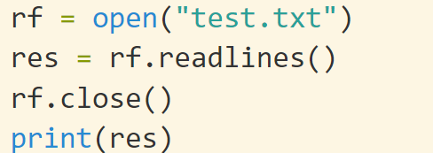
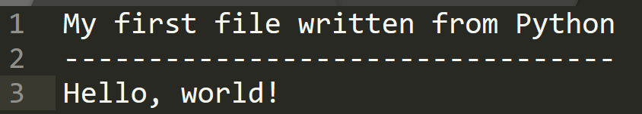
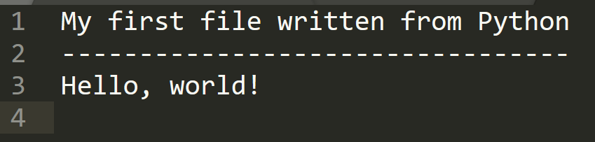
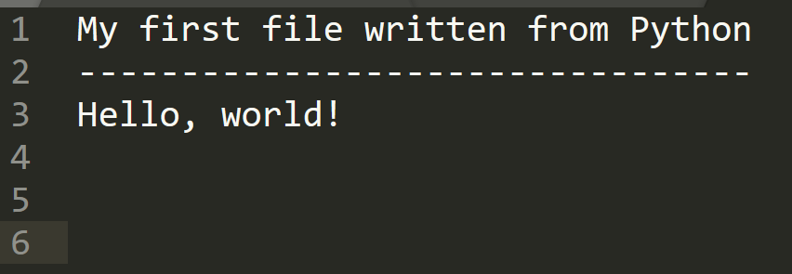
readlines() and EOF
readlines(): Reads and returns a list of lines from the file.
EOF: end of file. 文件结束标志

Slide 32
Binary files: read()
read([n]) methods read n bytes from the file. It will read the complete contents of the file into a string by default
When we read() from the file we’re going to get bytes back rather than a string.
f = open("somefile.txt")
content = f.read()
f.close()
words = content.split()
print("There are {0} words in the file.".format(len(words)))
f = open("somefile.zip", "rb") # r: read; b: binary file
g = open("thecopy.zip", "wb") # w: write; b: binary file
while True:
buf = f.read(1024) # read 1024 bytes
if len(buf) == 0: # if buf is empty, then it is the end of the file.
break
g.write(buf)
g.close()
f.close()

Slide 33
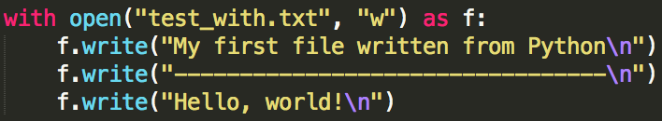
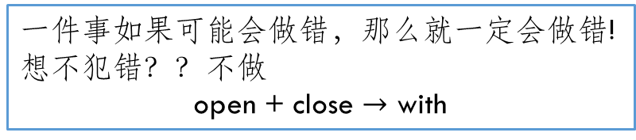
一件事如果可能会做错，那么就一定会做错!
想不犯错？？不做
open + close $→$ with
With statement
Forget close() is a common mistake in programming. The solution is to sidestep it
Python’s with statement provides a very convenient way of dealing with the situation where you have to do a setup and teardown to make something happen.
It is good practice to use the with keyword when dealing with file objects. The advantage is that the file is properly closed after its suite finishes, even if an exception is raised at some point
After a file object is closed, either by a with statement or by calling f.close(), attempts to use the file object will automatically fail
You won’t need to close() yourself. In fact, you cannot call close() now
with will be used repeatedly in other modules later

Slide 34
List comprehension
Python程序员的自我修养

Slide 35
Iterable (可迭代)
for x in collection_a:
In python, for could be used to loop over collection_a, whose type may be:
list, tuple, str, dict, set, range, etc..
a virtual index for x: loop over them from left to right
An iterator is an object that can be iterated upon, meaning that you can traverse through all the values
Technically, in Python, an iterator is an object which implements the iterator protocol, which consist of the methods __iter__() and __next__()
Lists, tuples, dictionaries, and sets are all iterable objects. They are iterable containers which you can get an iterator from
All these objects have a iter() method which is used to get an iterator:
一个类，如果实现了__iter__(), __next()__函数，则可以通过iter()来获得它的迭代器，从而配合next()函数遍历它，实现连续访问
和这个类对应的iterable (iterator): 迭代器、广义下标. 可以用for来遍历
回顾：for x in collection_a: 给定后，修改x不改变collection_a和迭代顺序
iter()+next() 获取collection_a的迭代顺序

Slide 36
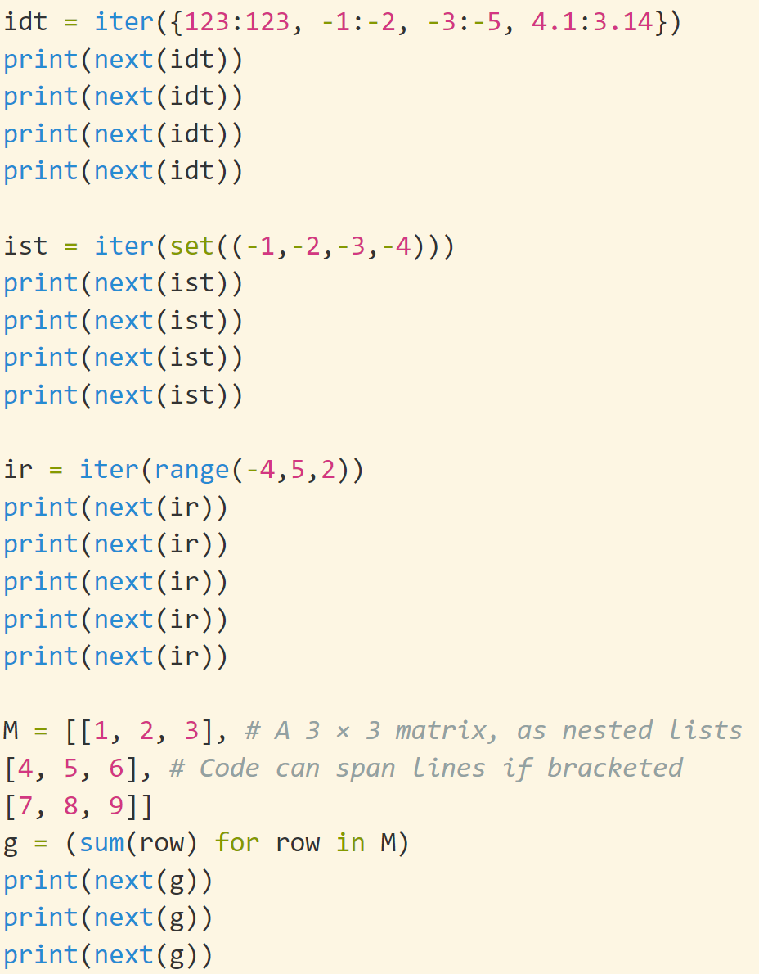
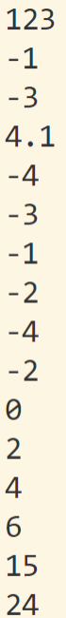
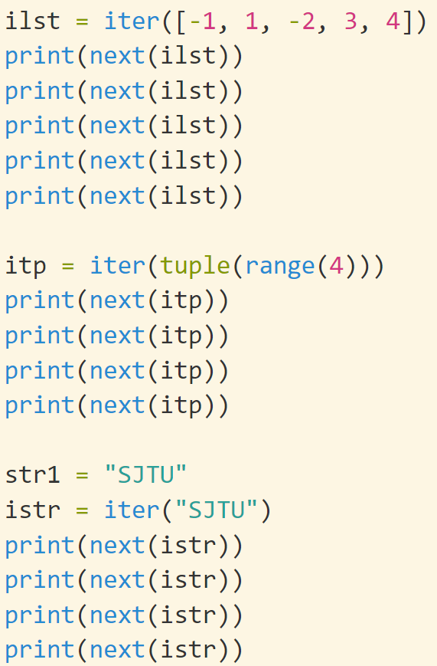
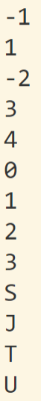
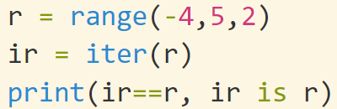
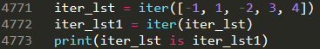
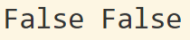
iter(), next()
迭代器的迭代器是自己

Slide 37
iterable
In a nutshell, an object is iterable if it is either a physically stored sequence in memory, or an object that generates one item at a time in the context of an iteration operation—a sort of “virtual” sequence. More formally, both types of objects are considered iterable because they support the iteration protocol—they respond to the iter call with an object that advances in response to next calls and raises an exception when finished producing values.
The generator comprehension expression we saw earlier is such an object: its values aren’t stored in memory all at once, but are produced as requested, usually by iteration tools. Python file objects similarly iterate line by line when used by an iteration tool: file content isn’t in a list, it’s fetched on demand. Both are iterable objects in Python—a category that expands in 3.X to include core tools like range and map.
I’ll have more to say about the iteration protocol later in this book. For now, keep in mind that every Python tool that scans an object from left to right uses the iteration protocol. This is why the sorted call used in the prior section works on the dictionary directly—we don’t have to call the keys method to get a sequence because dictionaries are iterable objects, with a next that returns successive keys.
--Learning Python, p.120

Slide 38
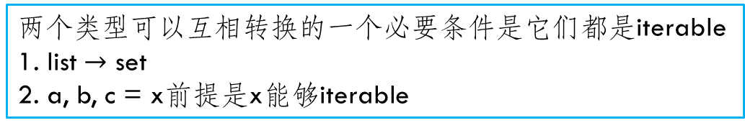
iterator VS. iterable
Terminology in this topic tends to be a bit loose. The terms “iterable” and “iterator” are sometimes used interchangeably to refer to an object that supports iteration in general. For clarity, this book has a very strong preference for using the term iterable to refer to an object that supports the iter call, and iterator to refer to an object returned by an iterable on iter that supports the next(I) call. Both these calls are defined ahead.
That convention is not universal in either the Python world or this book, though; “iterator” is also sometimes used for tools that iterate. Chapter 20 extends this category with the term “generator”—which refers to objects that automatically support the iteration protocol, and hence are iterable—even though all iterables generate results!
--Learning Python, p. 416
两个类型可以互相转换的一个必要条件是它们都是iterable
1. list $→$ set
2. a, b, c = x前提是x能够iterable

Slide 39
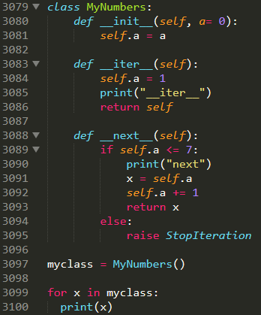


仅供了解
Create an Iterator
To create an object/class as an iterator you have to implement the methods __iter__() and __next__() to your object.
The __iter__() method acts similar, you can do operations (initializing etc.), but must always return the iterator object itself.
The __next__() method also allows you to do operations, and must return the next item in the sequence.
To prevent the iteration to go on forever, we can use the StopIteration statement.
For 的过程，就是背后调用__iter__, __next__的过程

Slide 40


仅供了解
Create an Iterator
系统自定义的list, tuple等实现了__iter__(), __next__()
自定义的类型，必须自己实现
For 遍历过程中，自动调用__iter__(), __next__()的
对于定义了__iter__(), __next__()的自定义类，可以通过定义iter(),生成迭代器， next()进行迭代
iter(), next()分别对应于__iter__(), __next__()

Slide 41

Quiz
A. 1 [0, 2, 3] B. 1 [1, 0, 3]
C. 1 [1, 2, 3] D. 1 [1, 1, 3]
先打包(pack)，再开箱(unpack)
L(i), i = L(0), 0 = 1, 0
i, L(i) = 1, 0
i = 1
L(1) = 0
1, [1, 0, 3]

Slide 42


List comprehension (列表推导)
List是python的核心
Now we will introduce a simple alternative to create a list of squares
Grammar
单重循环 [expression for target in iterable if conditon]
多重循环 [expression for target1 in iterable1 if condition1
for target2 in iterable2 if condition2 ..
for targetN in iterableN if conditionN]
A list comprehension consists of brackets [ ] containing an expression followed by a for clause, then zero or more for or if clauses
The result will be a new list resulting from evaluating the expression in the context of the for and if clauses which follow it
List comprehension can be nested

Slide 43


if
嵌套
函数
如何创建新的list
for
list comprehension
[0]*n
List(range()), list(set), list(str)
根据需要合理使用
清晰，可读，正确
比for更快

Slide 44


List is fast
纯python代码会很慢。部分python代码后面有c实现，尽可能用系统自带的实现。譬如sum()
能够用列表操作，就不要用for， for很慢。Python对list提供了很多操作
Single instruction, multiple data (SIMD) is a type of parallel processing. (单指令多数据: 一条高速路，多条车道)
List slice+ List comprehension: lst1[a,b,d] = lst2[a,b,d] # Sometimes, SIMD
大概相差一个数量级

Slide 45
generator (生成器、发电机)
Why range(n)? Why not list(n)?
list()=[]*(10**20)? 天文数字的空间存储数据！
range(n): n =10**20
We need only one element in each iteration!
没有必要一次性生成所有元素。要的时候再生成 (按需供应)
range(n) is a generator: its values aren’t stored in memory all at once, but are produced as requested, usually by iteration tools
Generator: Produce results on demand
Generator functions (available since 2.3) are coded as normal def statements, but use yield statements to return results one at a time, suspending and resuming their state between each
Generator expressions (available since 2.4) are similar to the list comprehensions of the prior section, but they return an object that produces results on demand instead of building a result list
Because neither constructs a result list all at once, they save memory space and allow computation time to be split across result requests

Slide 46







yield：generator function
def gensquares(N):
for i in range(N):
yield i ** 2 # Resume here later
This function yields a value, and so returns to its caller, each time through the loop; when it is resumed, its prior state is restored, including the last values of its variables i and N, and control picks up again immediately after the yield statement
除了返回函数值，yield比return还多了中间状态，可以循环返回
Generator是自己的iterator

Slide 47



Generator Expressions: Iterables Meet Comprehensions
Syntactically, generator expressions are just like normal list comprehensions, and support all their syntax —including if filters and loop nesting—but they are enclosed in parentheses instead of square brackets (like tuples, their enclosing parentheses are often optional):
不加括号()[]是语法错误

Slide 48


generator$→$list/dict/set/tuple comprehension
tuple(generator): 元组推导
dict(generator): 字典推导
set(geneartor): 集合推导

Slide 49






Slide 50




list(generator)
很隐秘的bug
list(generator)会在内部将generator循环一遍，即generator的iter()到达末尾
不要一遍修改一个iterator，一边遍历它：bug相对论
复习ppt 6.1

Slide 51
Functional Programming
函数式编程

Slide 52
Function: first-class citizen in Python
What is a function? Def ……
A first-class function is not a particular kind of function. All functions in Python are first-class functions.
FCC: Treat function as int, str, float, etc.
Can be used as parameters
Can be used as a return value
Can be assigned to variables
Can be stored in data structures such as hash tables, lists, ...
Actually, very roughly and simply put, FCF's are variables of the type 'function' (or variables which point to a function). You can do with them everything you can do with a 'normal' variable
To say that functions are first-class in a certain programming language means that they can be passed around and manipulated similarly to how you would pass around and manipulate other kinds of objects (like integers or strings). You can assign a function to a variable, pass it as an argument to another function, etc. The distinction is not that individual functions can be first class or not, but that entire languages may treat functions as first-class objects, or may not.

Slide 53




Functions are data
函数式编程：数据不变，函数变
Python built-in functions: len, id, type, str, int, float, print

Slide 54




Default arguments
默认参数可以看做函数的属性
在定义的时候初始化
函数内的变量会随着函数的调用完成而销毁
默认参数是函数的一种状态，在函数定义时创建，会一直保存下来
默认参数在参数列表中要放在非默认参数后面
参数名可以和变量名重名
一般情况下，默认参数作为系统的属性，不要修改
如果需要可用None作为默认参数

Slide 55
Default arguments
默认参数可以看成函数的属性
在函数定义的时候初始化
函数的默认参数保存在funcname.__defaults__中
Default parameter values are evaluated from left to right when the function definition is executed. This means that the expression is evaluated once, when the function is defined, and that the same “pre-computed” value is used for each call. This is especially important to understand when a default parameter is a mutable object, such as a list or a dictionary: if the function modifies the object (e.g. by appending an item to a list), the default value is in effect modified. This is generally not what was intended. A way around this is to use None as the default, and explicitly test for it in the body of the function, e.g.:
默认参数在函数定义时(注意：不是执行时)初始化，id(x)永远不变
如果默认参数的类型可以被修改，那么默认参数可以变
如果不可以被修改，那么不变
无论如何，id不变
https://docs.python.org/3.5/reference/compound_stmts.html#function-definitions

Slide 56




设置为None或者一个不会出现的值

Slide 57


Function Attributes
dir(func): func内部所有的属性
__name__
__code__
__doc__
__dict__
Self defined attributes: func.variable

Slide 58


Function: late binding
函数在定义的时候不会自动执行
函数的参数在调用时才会确定(late)
函数如果使用外部变量，那么外部变量的值在函数调用时才确定，不是在函数定义时决定
去掉a=“耗子尾汁”也不影响
powa由调用时的a决定，不是定义时的a

Slide 59


函数在定义的时候不会自动执行
函数的参数在调用时才会确定
默认参数在函数定义时就确定了
Late binding: solution
函数如果使用外部变量，那么外部变量的值在函数调用时才确定，不是在函数定义时决定
如果需要在定义时就确定：用默认参数 (默认参数在函数定义时就确定了)
powa中a=7

Slide 60




循环可以展开
三个要点
函数在定义的时候不会自动执行
函数的参数在调用时才会确定
默认参数在函数定义时就确定了

Slide 61




Closure 闭包
Functions could be nested inside another function
Closure is a functional programming concept, which is called function factory (函数工厂) in design pattern. It should satisfy the following:
函数嵌套：内部函数、外部函数
内部函数引用外部函数的数据
内部函数被外部函数返回
__closure__: 闭包数据

Slide 62

Decorator 装饰器
Learning python: Ch. 39
Decorator are very powerful and useful tool in Python since it allows programmers to modify the behavior of function or class. Decorators allow us to wrap another function in order to extend the behavior of wrapped function, without permanently modifying it
In Decorators, functions are taken as the argument into another function and then called inside the wrapper function
函数闭包：被装饰函数作为参数传入
内嵌函数调用被装饰函数，同时增加新的行为
外部函数返回内嵌函数
不改变被装饰函数代码的情况下，增广其功能

Slide 63




Decorator: @
等价写法 @decorator_name
@decorator_name 放在被装饰函数定义前
回顾：类方法 @classmethod

Slide 64


Decorate 3rd party functions
It is also possible to decorate third party functions, e.g. functions we import from a module. We can't use the Python syntax with the "at" sign in this case

Slide 65


Functions with arbitrary parameters
f(*args, **kwargs)

Slide 66


Functions with return value
https://www.geeksforgeeks.org/decorators-in-python/

Slide 67



Slide 68


https://www.python-course.eu/python3_decorators.php#First-Steps-to-Decorators

Slide 69



Slide 70
语义辨析：statement Vs. expression
Expressions only contain identifiers, literals and operators, where operators include arithmetic and boolean operators, the function call operator () the subscription operator [] and similar, and can be reduced to some kind of "value", which can be any Python object
2*2, x and y or z, (x, y)[z>w]
is_prime(123) # return True or False
Statements, on the other hand, are everything that can make up a line (or several lines) of Python code. Note that expressions are statements as well
x = 123
def func():, class Test():
An expression evaluates to a value. A statement does something
Expressions produce at least one value
Literals
Literals are notations for constant values of some built-in types.
https://docs.python.org/3/reference/lexical_analysis.html#literals
https://www.programiz.com/python-programming/variables-constants-literals

Slide 71




$$λ$$
Lambda： 匿名函数
A lambda function is a small anonymous function
A lambda function can take any number of arguments, but can only have one expression
The return value is the value of the expression
关键字 lambda
lambda arguments : expression
高阶函数

Slide 72


Lambda: sorted
The sorted() function returns a sorted list of the specified iterable object
List.sort(), sort in place, return None
https://docs.python.org/3/howto/sorting.html
Parameter:
key Optional. A Function to execute to decide the order. Default is None
reverse Optional. A Boolean. False will sort ascending, True will sort descending. Default is False
Key: Based on the returned value of the key function, you can sort the given iterable.
The function may be lambda, self-defined function
Operator: https://docs.python.org/3/library/operator.html#module-operator
In python2, cmp may be used to compare two elements and sort them
CMP is removed in Python 3. You must implement >=, <=, >, <, ==, != (rich comparison)
https://py.checkio.org/blog/how-did-python3-lose-cmd-sorted/

Slide 73



Slide 74


Lambda + dict
A lambda expression could be the value of a dict
dict[key]=lambda x,y: x+y
An alternative to if … elif…elif…else statement

Slide 75


Lambda: 蚂蚁虽小
仅供了解
A lambda function can take any number of arguments, but can only have one expression
Expression VS. Statement: Expressions should have value
Lambda cannot contain print(), “=“ assignment, etc
Python 3.8, := assignment
Lambda is almost as power as normal python statement: If you know what you’re doing, though, you can code most statements in Python as expression-based equivalents.
if a: b else: c的N种写法
b if a else c
(c, b)[a]
((a and b) or c)

Slide 76


map 映射
相当于Loop
map(function, iterable, ...): for x in iterable: f(x)
Return an iterator that applies function to every item of iterable, yielding the results.

Slide 77


filter 过滤
filter(function, iterable): select the element x where function(x) is True
Construct an iterator from those elements of iterable for which function returns true. iterable may be either a sequence, a container which supports iteration, or an iterator. If function is None, the identity function is assumed, that is, all elements of iterable that are false are removed.

Slide 78




reduce: basic
从头到尾迭代：sum
The reduce(fun, iterable) function is used to apply a particular function passed in its argument to all of the list elements mentioned in the sequence passed along
This function is defined in “functools” module

Slide 79

reduce: initializer
从头到尾迭代：sum
reduce(fun, iter, initial)
reduce的工作流程是：
1. 有initial参数的情况：
$y_{1}=f\left(x_{0},x_{1}\right), y_{2}=f\left(y_{1},x_{2}\right),…,f_{n}=f(y_{n−1},x_{n})$
2. 没有initial参数的情况：
$$y_{1}=f\left(x_{1},x_{2}\right), y_{2}=f\left(y_{1},x_{2}\right),…,f_{n}=f(y_{n−1},x_{n})$$

Slide 80



Slide 81

Example 1:
删除一个例表中重复元素，并保留原有顺序

Slide 82
Example 2:
找出一个集合中第二小的元素

Slide 83


Example 3:
判断一个数是不是happy number：即各个位的平方和最后变成1

Slide 84

变量的作用域
一个变量名可能存在的区域：LEGB
系统内置的变量，譬如pow, print, id等等，称为built-in
模块里面的全局变量，称为global
单个函数内部变量，称为local
嵌套函数内部的变量，称为enclosing
Python的设计原则
不同区域的变量互不干扰，互不影响
同一个区域，一个变量只能属于LEGB中一种，只有一个起作用
变量在一个区域的LEGB属性保持不变
x属于一个封闭区域(Enclosing)，但是既不global也不local

Slide 85




Enclosing
x: global. x3: local
x1, x2: enclosing
在一个密封环境中, def内部
相对于x是local
相对于x3是global，可以被函数f2, f3使用

Slide 86
Namespace 名字空间
assignments always determine name scopes unambiguously
Namespaces : A namespace is a container where names are mapped to objects, they are used to avoid confusions in cases where same names exist in different namespaces. They are created by modules, functions, classes etc.
名空间中：同一个范围的名字所构成的空间
外部变量也会在空间产生作用，但是不属于这个空间
名空间由变量定义唯一决定
一个相同名字的变量，可能出现在不同的名空间，也就有不同的作用域
名空间local、global、enclosing、built-in
local：函数内部
global：模块顶层
嵌套函数怎么算: Enclosing
built-in 系统自定义的：pow, print, sum等等
python中变量必须先定义再使用
赋值语句variable = value
预示新的变量及其作用域的诞生
使用一个变量不会改变其作用域

Slide 87



global
Global and Local

Slide 88




global
在全局范围以外的区域修改一个全局变量，需要提前声明其为global
同一个作用域，只有一个同名变量起作用
UnboundLocalError: local variable 's' referenced before assignment
f()内部的s和外部的s是两个不同的变量

Slide 89

Namespace: LEGB Rule
Python’s name-resolution scheme is sometimes called the LEGB rule
When you use an unqualified name inside a function, Python searches up to four scopes—the local (L) scope, then the local scopes of any enclosing (E) defs and lambdas, then the global (G) scope, and then the built-in (B) scope—and stops at the first place the name is found.
If the name is not found during this search, Python reports an error.
Local: When you assign a name in a function (instead of just referring to it in an expression), Python always creates or changes the name in the local scope, unless it’s declared to be global or nonlocal in that function.
Global: When you assign a name outside any function (i.e., at the top level of a module file, or at the interactive prompt), the local scope is the same as the global scope— the module’s namespace.
变量赋值决定名空间
LEGB原则
同一个空间中，一个名字只有唯一一个LEGB属性

Slide 90
LEGB: 从内到外，从小到大
各占一方、互不关涉
变量赋值决定名空间
LEGB原则
同一个空间中，一个名字只有唯一一个LEGB属性
L-Local (function)：函数内的名字空间 E-Enclosing function locals：外部def的名字空间(例如类，嵌套函数) G-Global (module)：函数定义所在模块（文件）的名字空间 B-Builtin (Python): Python内置模块的名字空间

Slide 91




Slide 92




Slide 93




nonlocal
一个变量，既不是local也不是global
The nonlocal keyword is used to work with variables inside nested functions, where the variable should not belong to the inner function
Use the keyword nonlocal to declare that the variable is not local
Global, nonlocal, local: three status, only one should exist in a program

Slide 94

Why nonlocal is wrong?

Slide 95
Pythonic
论一个python程序员的修养
最高原则 import zen
KISS: Keep It Simple
EIBTI: Explicit is better than implicit
Python的调调
List comprehension, lambda, generator, decorator
不要滥用map, filter, reduce, list comprehension
清晰，可读，正确，可维护

Slide 96
Programming Paradigm
Imperative
函数变，数据变
Object
函数不变，数据变
Functional: Scala, Haskell
函数变，数据不变

Slide 97
Reading
SICP
Learning Python

